Slide 1
Case Study-Exploratory Data Analysis
By
Lakshmi Narashimman. D

Slide 2
Problem Statement
The loan providing companies find it hard to give loans to the people due to their insufficient or non-existent credit history. Because of that, some consumers use it as their advantage by becoming a defaulter. Suppose you work for a consumer finance company which specialises in lending various types of loans to urban customers. You have to use EDA to analyse the patterns present in the data. This will ensure that the applicants capable of repaying the loan are not rejected.
When the company receives a loan application, the company has to decide for loan approval based on the applicant’s profile. Two types of risks are associated with the bank’s decision:
If the applicant is likely to repay the loan, then not approving the loan results in a loss of business to the company
If the applicant is not likely to repay the loan, i.e. he/she is likely to default, then approving the loan may lead to a financial loss for the company.

Slide 3
Findings

Slide 4
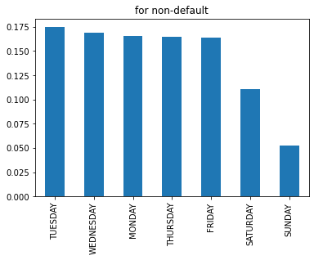
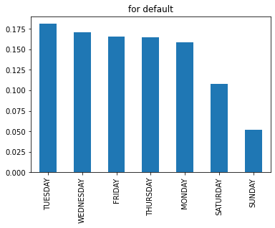
Start of application Processes
Application processes are generally less during Saturdays and Sundays for defaulters and non-defaulters.
Most application processes start during Tuesdays

Slide 5
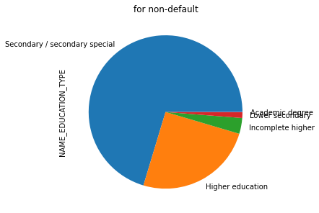
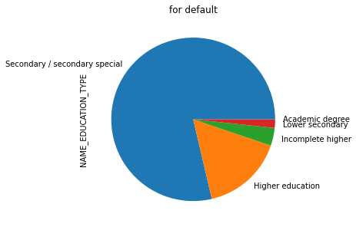
What is educational background of people who majorly apply for loans?
Customers with secondary or special education majorly apply for loans in the bank

Slide 6
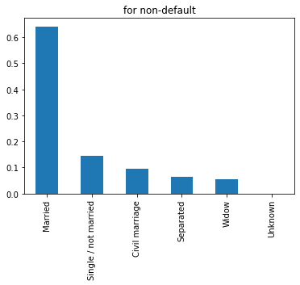
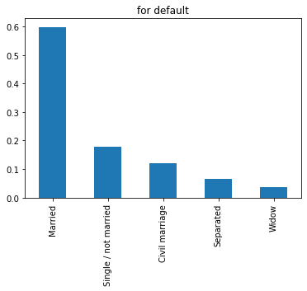
Do married people take more loans?
Married People majorly apply for loans than singles or widows

Slide 7
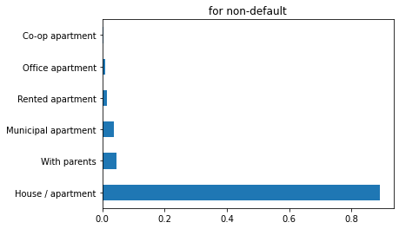
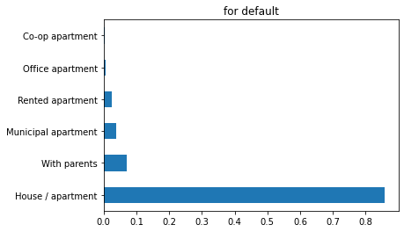
Do home owners apply for more loans?
Home or apartment owners majorly apply for loans compared to rented and municipal apartment owners.

Slide 8
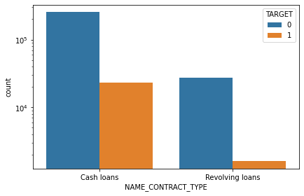
Cash loans versus Revolving Loans
Cash loans are highly disbursed compared to the revolving loans.

Slide 9
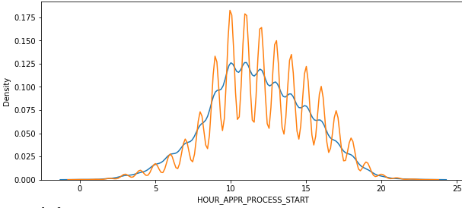
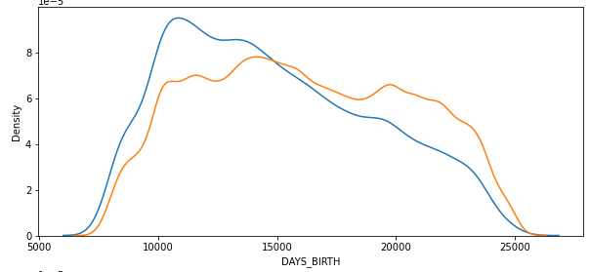
Loan applications and age of customers
The highest number of loan applications are made between 10 am to 2 pm
Customers between the ages of 27 to 41 are more likely to apply for loans

Slide 10
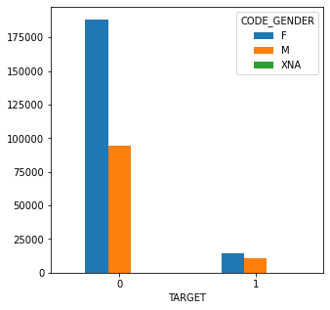
Which gender applies for loans majorly?
Females tend to make more loans than males

Slide 11
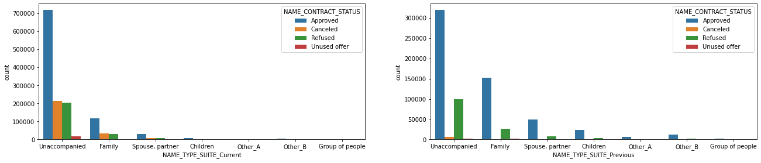
Who gets the highest number of loan approvals?
The unaccompanied gets the highest number of loan approvals during the previous and current time.

Slide 12
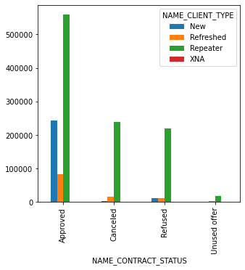
Repeated applications gets an upper hand in loan approvals
Repeated loan applications have higher likelihood to get more loan approvals

Slide 13
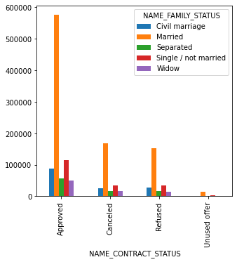
Married customers higher in loan approvals
Married customers have higher number of loan approvals

Slide 14
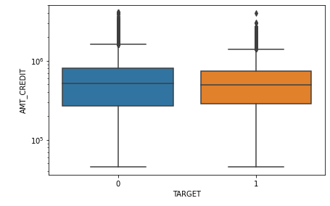
Credit amount>50000 means lesser default in paying loans
When credit amount is greater than 50000, customers are less likely to default paying loans

Slide 15
The major variables to be considered for loan prediction
1. DAYS_EMPLOYED
2. AMT_ANNUITY
3. NAME_INCOME_TYPE
4. CODE_GENDER
5. NAME_HOUSING_TYPE
6. NAME_EDUCATION_TYPE
7. AMT_INCOME_TOTAL
8. DAYS_BIRTH
9. AMT_CREDIT

Slide 16
Some recommendations
1. The time spent by banks in unused offers is high compared to other categories
2. Banks should minimize their time spent for unused offer

Slide 17
Thank You !

